Slide 1
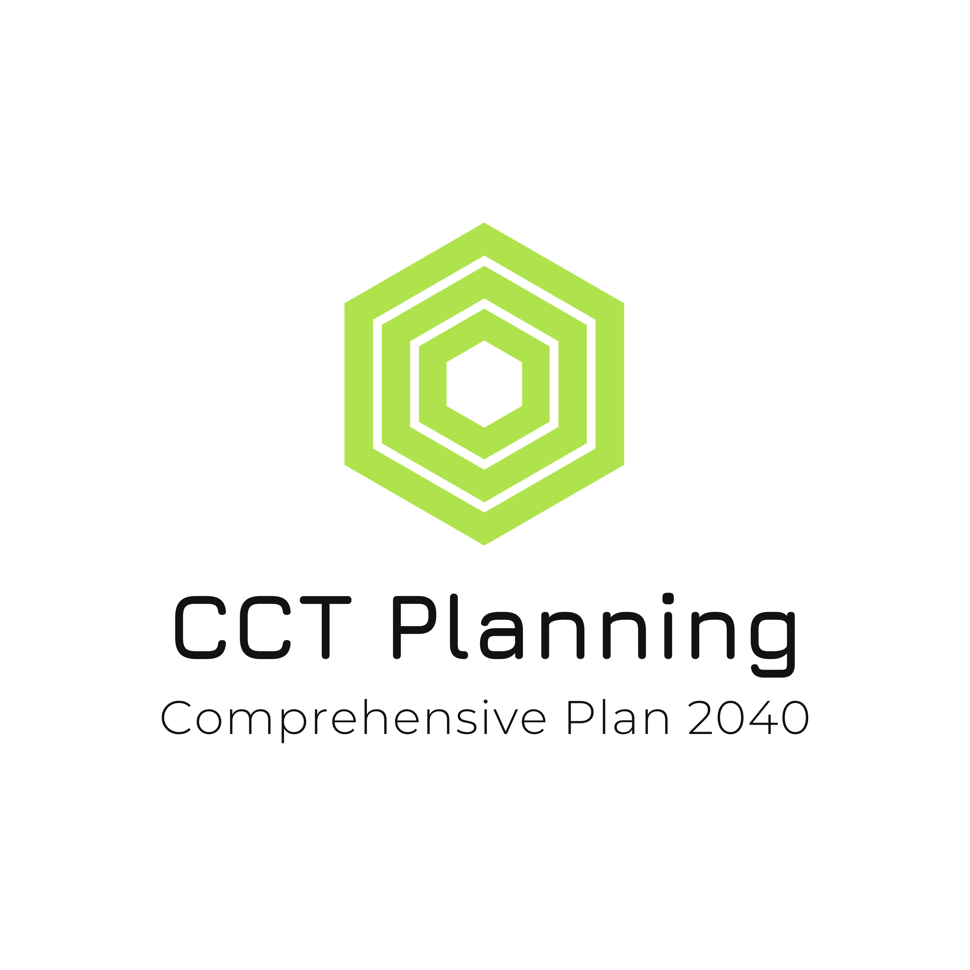
William J. Marchand
Enrolled Tribal Member (80%+ as are my two children)
Administrative Head of the Tribal Planning Department (CCT PLANNING) since 2015
CTFC Board of Director (2020-2021) throughout the Covid-19 Pandemic. Resigned from position to increase focus on raising my two small children.
Formerly lead Transportation Planner for the Colville Tribes (2013-2015)
Masters in Public Administration, Tribal Governance Emphasis
Omak District Voting Member. Omak born & raised. Former student at PSIS, Omak Elementary, Middle and High School
Masters in Urban and Regional Planning, Tribal Planning Emphasis

Slide 2
CCT Planning Functions
Lead Department on Land Use and Zoning/Permitting
Oversee the Colville Tribes Grants Procurement Process
Coordinate Economic Development Planning Efforts (Dept. partially funded by the EDA)
Technical support for tribal and neighboring communities (one example an MOU with Town of Nespelem for Planning efforts)

Slide 3
CCT Planning Projects Past & Present
Treatment Center Feasibility
Parks & Recreation Plan (only Tribe utilizing RCO dollars)
Economic Development Planning (Planning studies and coordination)
New Land Use Mapping/Zoning
Site Suitability/Rez Wide (Master Planning)
Simplifying Development Process
Economic Indicators/Legislative Database (Statistics)
Solid Waste Management Plan Update
Coordinating Population Study with Enrollment/Wilder

Slide 4
Population Study Project Development
1970’s
A goal of the Colville Tribes since the 1970’s (identifying future population impacts)
1978
Tribal Resolution from 1978
2012
Tribal Resolution from 2012
2019
CCT Planning identified policy approaches elsewhere (Wilder’s Population Studies for other Tribes)
2021
Colville Business Councill approved proceeding with a Study for CCT, utilizing Wilder, who had a track record elsewhere

Slide 5
Why do a Study?
Uncertainty regarding future population outcomes
A conventional population model would indicate there would be continuous growth
Contrary to conventional growth projections, CCT Enrollment is now seeing a decline (topped out at 9535 in 2019, now has declined for four straight years)

Slide 6
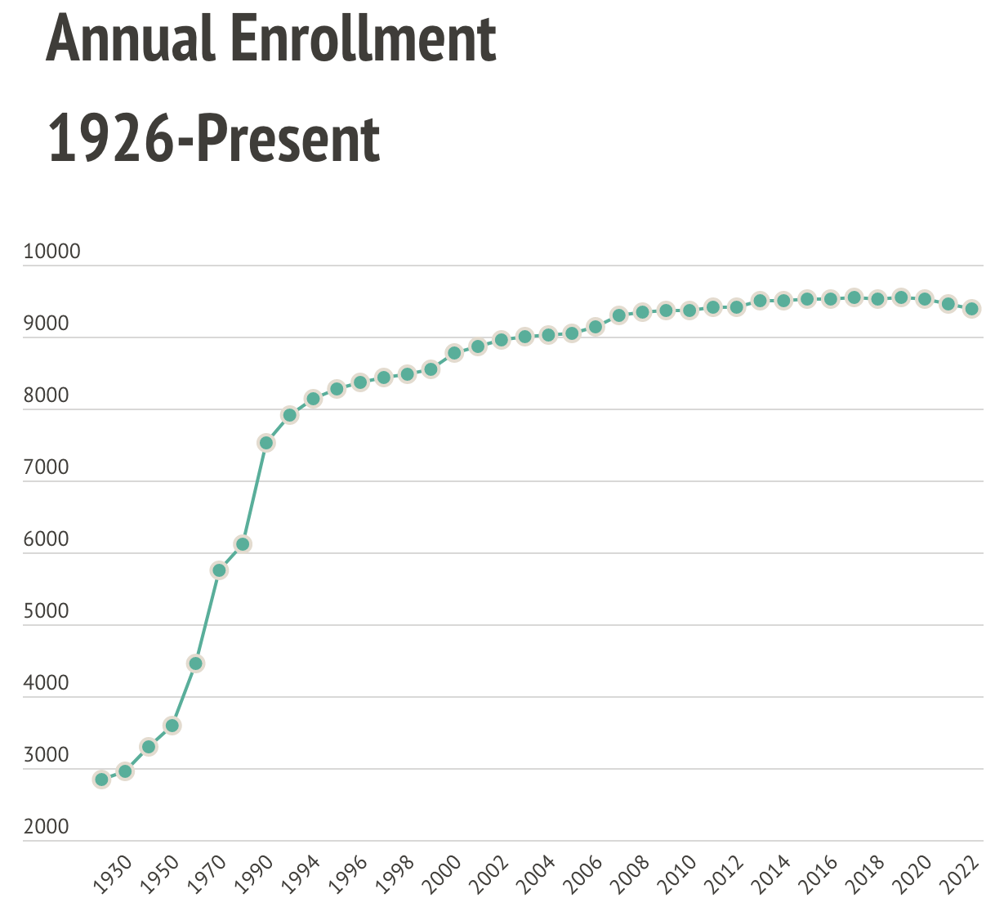

Slide 7
Why outsource?
CCT Planning can do projections on standardized population outcomes. Enrollment type data requires subject matter expert insight (i.e., a trained demographer). Standard demographic modeling would have indicated no decline in 2020
Enrollment Issues are Highly Politicized and Sensitive Work. Important that any type of work be apolitical. Wilder is a neutral third party with a track record of both success and professionalism. Particularly in Indian Country

Slide 8
Project Outcomes
NO changes to Enrollment Critiera. No changes to Enrollment Policies.
Identification of future outcomes of the Tribal enrolled population based on multiple scenarios (status quo, and others. Wilder Research will discuss next)

Slide 9
Contact Information
William J. Marchand
509-703-3427
William.marchand@colvilletribes.com
CCT Planning, Planning Manager

